Slide 1
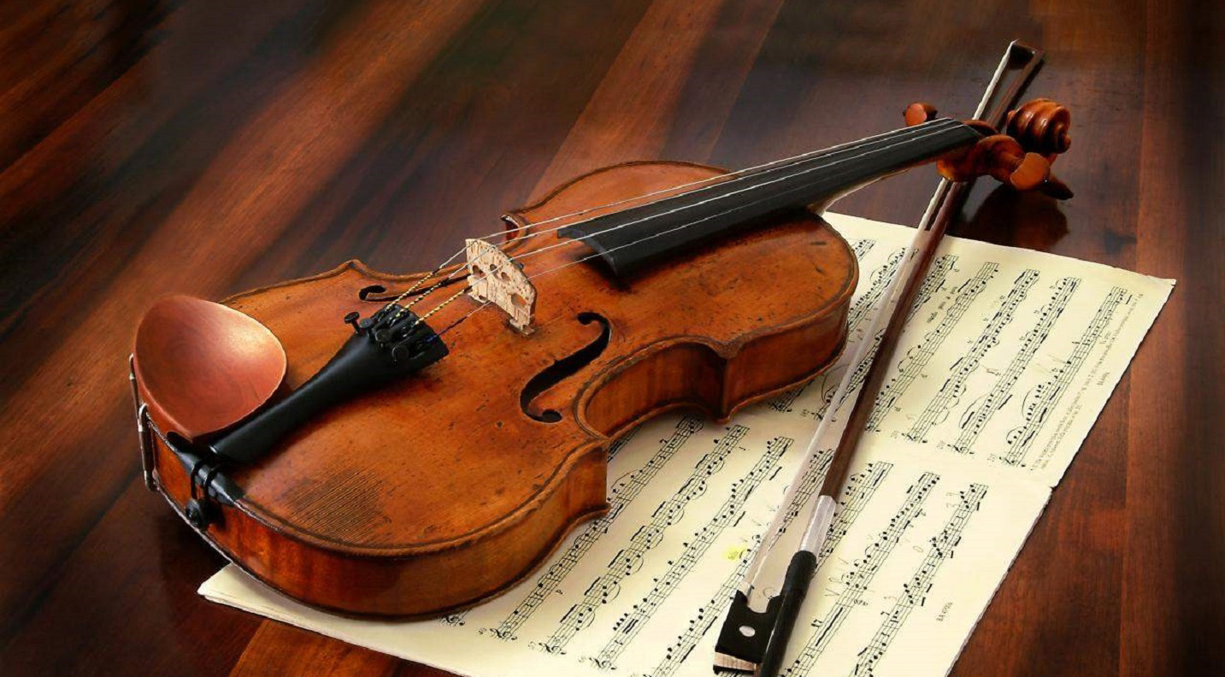
Armendariz Orchestra at Home
2020

Slide 2
Armendariz Orchestra at Home Welcome
Welcome to Armendariz Orchestra at Home
We understand that we are all experiencing big changes and so this power point was created to help ease us into our expectations as we move forward.

Slide 3
Armendariz Orchestra at Home Expectations
There will be both ”live sessions” through Zoom or with a prerecorded video and live chats as well as work for you to complete on your time. All of these live sessions will be available to be viewed at a later time. This means that you join the sessions whens its possible, and you watch them later if you couldn’t join at the designated times.
My goal is to keep the live sessions/lessons short so that you can have time to do the work. With that in mind there will need to be some rules.

Slide 4
Armendariz Orchestra at Home Classroom Rules
M-Make good choices
U-Use good manners
S-Speak, Sing, or Play when appropriate
I-Involve yourself
C-Care about your education and everyone else. Care about your apearence.

Slide 5
Armendariz Orchestra at Home Schedule
My Schedule looks a lot like yours.
Fridays I have virtual Office Hours. This is time for extra help.
Pop in when you need the extra help and understanding.
After 3:00PM is by appointment only.

Slide 6
Armendariz Orchestra at Home Friday Schedule
9:00-9:20 Advanced Violin
10:0-10:20 Advanced Viola
10:30-10:50 Advanced Cello and Bass
1:00-1:20 Beginner Violin
2:00-2:20 Beginner Viola
2:30-3:00 Beginner Cello and Bass

Slide 7
Armendariz Orchestra at Home Assignments
Assignments will be posted and submitted on Schoology.
Live Zooms and other chats will also count as grades, sometimes.

Slide 8
Armendariz Orchestra at Home
Let’s
Do
This!

